Slide 1





Concentrix
Different by Design
February, 2018
Notes:
1

Slide 2

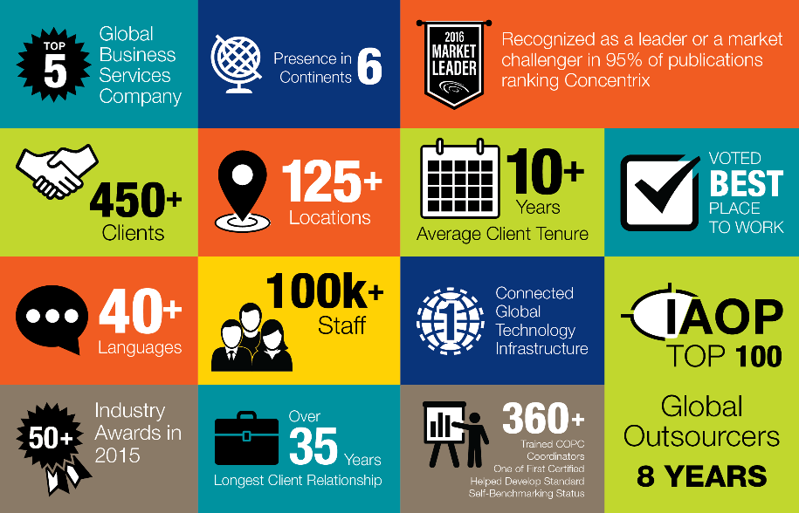
Concentrix by the Numbers
Notes:
Top 5 – Global Business Services Company
450+ Clients
40+ Languages
Over 50 Industry awards in 2016
Presence in 6 Continents
125+ Locations
100K+ Staff
890M+ Transactions handled annually
Single, globally connected Technology infrastructure
Developed COPC standard
Over 360 COPC coordinators - Helped develop standard and one of the 1st companies to implement COPC. Holder of self-benchmarking capability.

Slide 3









Our Values
All employees Understand, Believe, Live and Lead the Concentrix culture
Culture & Communication
Notes:
3

Slide 4
Our Operating Philosophy is Our 3Vs
Three interdependent principles guide the way each of us operate on a day-to-day basis. The 3Vs are key to our ability to deliver value faster – executing on long-term strategic objectives in short-term increments.
VISIBILITY
VELOCITY
VALUE
Visibility throughout the organization allows us to quickly see and address problems and opportunities…
Fostering a culture of listening and learning from the industry, our clients and from our people on the frontlines, visibility to the right information guides us to make the right decisions for the long-term good.
Velocity lets us quickly adapt to, even anticipate, changes in the marketplace and your business…
Velocity allows us to be opportunistic, timely in our response to new challenges, adaptable to market dynamics and ultimately to deliver benefits faster.
We ensure value to our staff, clients and shareholders is considered and upheld in all we do…
Upholding these 3Vs is how we’ve built successful relationships with our clients and how we know we’ll continue to be successful in the future.
Notes:
Underlying and supporting absolutely everything we do is our operating philosophy.. Our 3 Vs

Slide 5



We are Rich in Diversity and Talent
We are fanatical about our staff and recognize that our people are our best asset.
We are committed to finding and developing the world’s best talent.
We welcome staff who are passionate about solving today’s challenges and innovating for future opportunities.
We support and develop that talent to secure the best people in the industry for our clients and ourselves.
We invest in:
Recruitment
Training and development
Employee engagement
Leadership development
Reward and recognition
Career progression
Certifications and thought leadership
Notes:
Use examples to support our Different by Design approach.

Slide 6
Compensation and Benefits
Compensation
Annual review of salary levels to ensure competitiveness
Benefits
Medical plan, Life Insurance, Transportation allowance
Discounts on services and products
Work from home model
Performance linked bonuses
Move to quarterly measured and rewarded performance for agents
Annual incentive program for leadership

Slide 7
Employee Engagement
Quarterly Center Roundtables, Quarterly Town halls with new starters
CSR
Center events calendar (Team Building, After-work-get-together,
Annual engagement with causes selected on center level
Quarterly charity bazar: “Bake-a-smile”
Wellness month
“Manager for a Day”, Junior Achievement Bulgaria
Confidentiality speaking – internal communication channel
Employee engagement
Center breakfasts, pizza days, quarterly quiz on CNX culture

Slide 8
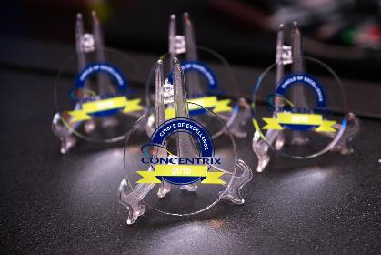
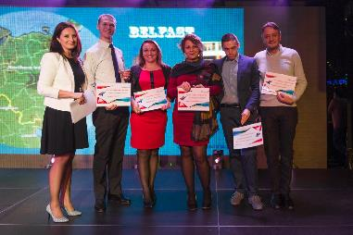
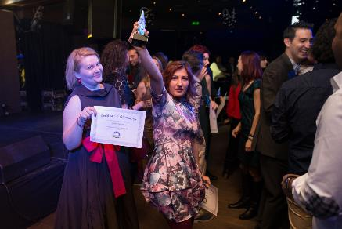
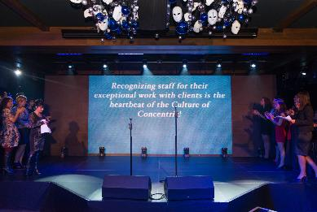
Global Recognition Programs
Circle of Excellence
President’s Club
Global Unsung Hero

Slide 9
Concentrix Bulgaria
Different by Design
Notes:
9

Slide 10






Diversity in its Full Spectrum
1000
staff
26
nationalities
51%
women in leadership roles
57%
women
25
months average
employee tenure
88%
bilingual
employee
70%
university graduates
16
languages served
30
years
average age
5%
multi-lingual
employee
18%
non-Bulgarian employed
22%
currently studying
Notes:
10

Slide 11

Concentrix Bulgaria: Office locations
Locations
  Sofia: established in 2007
  Varna: established in 2014
Services provided
  Customer Care
  Technical Support
  Order management
  Sales
  Shared Services
  Project Management
Work Environment
  Class A offices
  PCI Certified
  Secure & easy to commute
  Available space for fast expansion

Slide 12


Concentrix : The Innovative company in the Bulgarian Outsourcing sector
SOFIA (Bulgaria), June 16, 2016 - Fifteenth awards in the first edition of the Bulgarian Outsourcing Excellence Awards were handed out by the Bulgarian Outsourcing Association at the Awards Gala dinner at “Hilton Sofia” hotel. The awards are aimed at recognizing the success, business growth and leadership of the industry in six key categories for the sector – four categories, core for the industry and two bringing together the efforts of the business, local government and universities.
Concentrix won a Gold Award for Innovation in Automation by automating processes, which saved our client Cisco millions of dollars. This automation project cut expedited order time by 80%.
Concentrix also won a Silver Award for Innovation in Optimization. The Concentrix team, supporting the Xerox account, developed a tool that combines all the data into one screen, which helped agents reduce average handle time by 15% for our client Xerox.

Slide 13

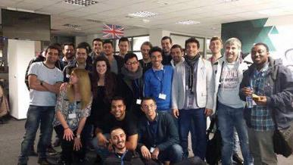
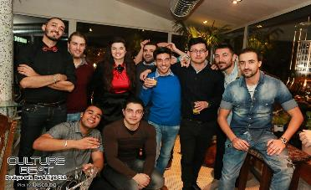
Relocation program
  Relocating from abroad
  up to 250 EUR travel refund after probation period
  7 Nights in a city center hotel
  Advance payment of 540 EUR net
  Relocating within Bulgaria
  up to 50 Euro travel refund after passing the probation period
  7 Nights in a city center hotel
  Single payment of 200 EUR net

Slide 14
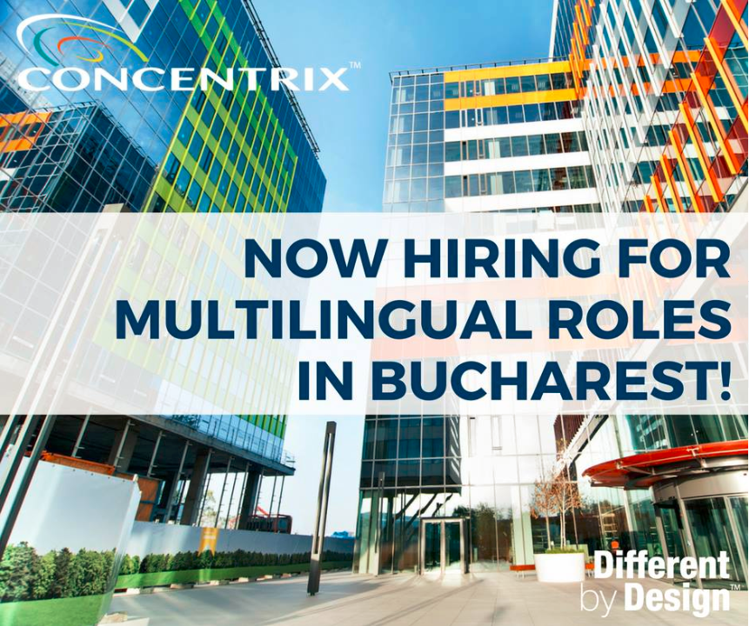

Opportunities in Concentrix Luton, United Kingdom and Concentrix Romania

Slide 15
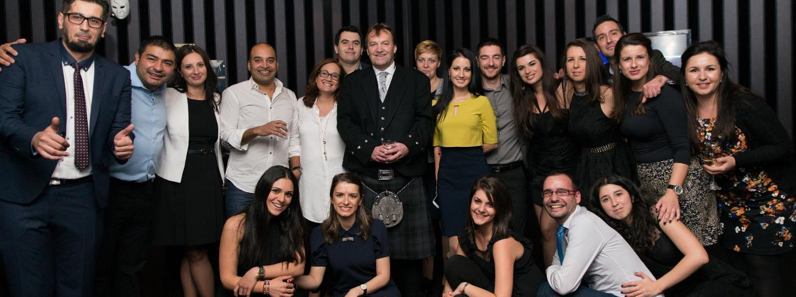
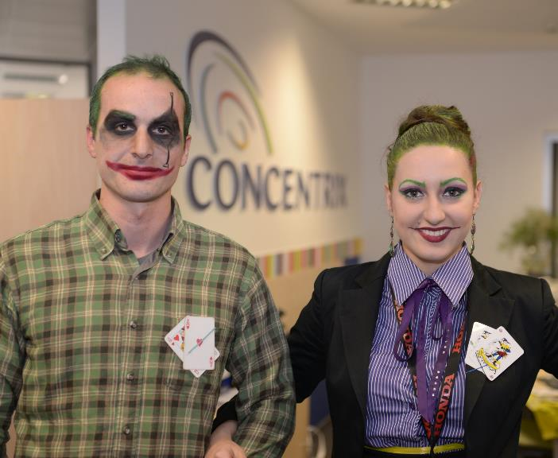
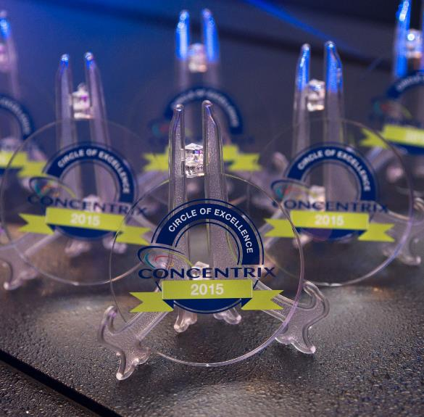
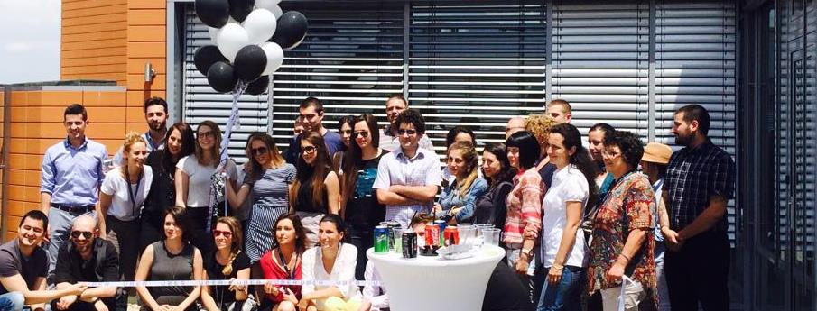



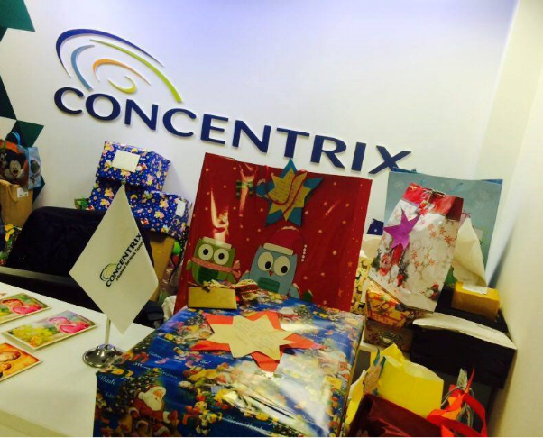
We are Different by Design and We are…

Slide 16
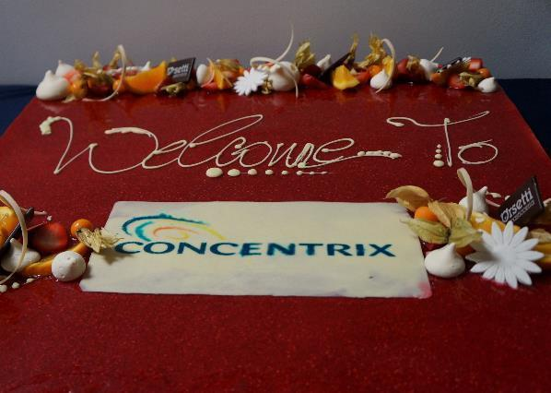
Let’s grow together

